Slide 1
Programming Fundamentals
BY
Adnan Amin
Lecturer, IMSciences

Slide 2
Exceptions
An exception is a program error that causes the program to crash. Try/except allows you to gracefully handle exceptions.
For example:
A number divided by zero
It is your responsibility to write code that responds to exceptions when they are raised and prevents the program from crashing unexpectedly.
Technique is used is known as exception handler, and it is written using the try/except syntax.
Syntax:
Try:
Statement 1
Statement N
except ExceptionName:
Statement(s)
IOError
ValueError

Slide 3
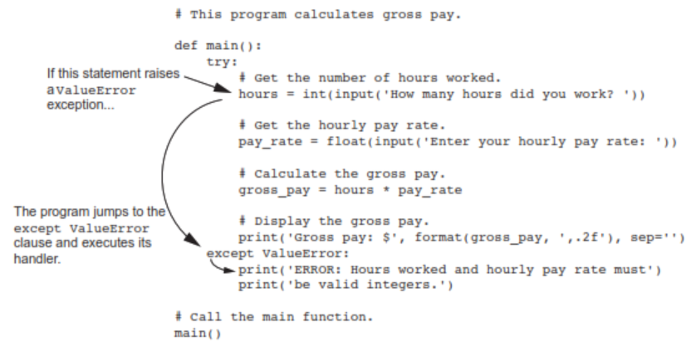
Exception Handler

Slide 4
Handling Multiple exceptions
try:
Statement(s)
except IOError:
Statement(s) #An error occured trying to read the file.
except ValueError:
Statement(s) #Non-numeric data found in the file.
except:
Statement(s) #Using One except Clause to Catch All exceptions
except ValueError as err:
print(err)

Slide 5
The else Clause
The try/except statement may have an optional else clause, which appears after all the except clauses.
General format:
try:
statement (s)
except ExceptionName:
statement (s)
else:
statement (s)
The statements in the else suite are executed after the statements in the try suite, only if no exceptions were raised. If an exception is raised, the else suite is skipped.

Slide 6
The finally Clause
The try/except statement may have an optional finally clause, which must appear after all the except clauses.
General format:
try:
Statement(s)
except ExceptionName:
Statement(s)
finally:
Statement(s)
The statements in the finally suite execute whether an exception occurs or not. The purpose of the finally suite is to perform cleanup operations, such as closing files or other resources.

